Slide 1

Presentation on
“ LANE FOLLOWING MOBILE ROBOT”
By
Group no. 7
Group members
CHINMAY BHOIR TU1F1819006
MAHENDRA GUDLA TU1F1819009
SUCHITA BOGA TU1S1920004
SANDHYA YADAV TU1S1920008
Under the Guidance of
Mr. Vijaykumar Chaudhari
Department of Electronic Engineering
TERNA ENGINEERING COLLEGE

Slide 2
Contents
Abstract
Introduction
Literature review
Problem definition
Methodology
Hardware and Software requirements
Block diagram
Flow of project
Circuit diagram
Results
Limitations
Future scope
Conclusion
References

Slide 3
Abstract
Lane Following is one of the most important aspects of robotics. It is designed to move automatically and follow the lane using Raspberry Pi Camera to identify the lane and thus assisting the robot to stay on the track. This project aims to implement the algorithm and control the movement of the robot by proper control parameters and thus achieving better performance. This ensures robust lane fitting even if the road plane changes and also detects obstacles in between the lane and takes action accordingly.

Slide 4
Introduction
Computer vision is at the core of perception algorithms and cameras are the closest equivalent technology to how humans perceive the world around them.
Camera-based Lane detection is used to detect the lanes and position the robot in between the lanes properly and prevent the lane departure.
The platform was designed around the Raspberry Pi single board computer and uses Arduino Nano to control the movement of the chassis.
Sensing a lane and maneuvering the robot to stay on course, while constantly correcting wrong moves using feedback from the sensor forms a simple yet effective system. To achieve autonomous navigation of mobile robot, perception of surroundings, driving path planning and robot control algorithm are key features.

Slide 5
Literature Survey
PAPER | AUTHOR | PUBLICATIONS | E-ISSN | SENSORS & BOARDS
Autonomous Self-Driving Car using Raspberry Pi Model | Mr. Nihal A Shetty, Mr. Mohan K, Mr. Kaushik K | International Journal of Engineering Research & Technology (IJERT) | 2278-0181, Volume 7, Issue 08 | Raspberry Pi, Arduino UNO & camera
A lane detection method based on 3D-LiDAR | Yu-Fang Wang and Yi-Shueh Tsai | Automotive Research & Testing Center (ARTC), Changhua, Taiwan (R.O.C) | 2018 | 3D-LiDAR
Lane Detection Algorithm Using LRF for Autonomous Navigation of Mobile Robot | Jong-Ho Han and Hyun Woo Kim | Test & Evaluation Division, Korea | Appl. Sci. 2021, 11, 6229. https://doi.org/10.33 90/app11136229 | 3D map, laser range finder
Vision-Based Adaptive Cruise Control Using Pattern Matching | Ritesh Kanjee, Asheer K. Bachoo, Johnson Carroll | 2013 6th Robotics and Mechatronics Conference (RobMech) Durban, South Africa | 978-1-4799-1518-7/13/$31.00©2013 IEEE | PI Controller, Autonomous Vehicle, Single Camera

Slide 6
Problem Definition
In the industries, carriers are required to carry products from one point to another point which are usually in separate buildings or blocks. Conventionally, carts or trucks were used with human drivers. Unreliability and inefficiency in this part of the assembly line formed the weakest link.
The task is to build an autonomous car that can basically control or change the course of direction without any human input. One of the use cases are in industries where certain goods are being placed in from one area to another and using this system, we can properly reduce manpower and time delay.

Slide 7
Methodology
The Lane following Mobile Robot uses four DC motors to control rear and front wheels.
It has Raspberry Pi Camera Sensor for detection of white lines.
The proposed system detects the drivable region and road lines drawn on the floor from Camera data.
The Path consists of a white line on a grey surface. The control system senses these lines and manoeuvre the robot to stay on course.
The proposed system consist of following terms:
Computer Vision
Digital Image Processing
Region of Interest
Canny Edge Detection
OpenCV
Grayscaling
Thresholding

Slide 8
Hardware and Software requirements
Hardware requirements
Software requirements
Raspberry Pi 3 Model B+
Arduino Nano
Raspberry Pi Camera
L298N Motor Driver
DC Motor
Power Bank
Battery
Raspberry Pi OS
Arduino IDE

Slide 9
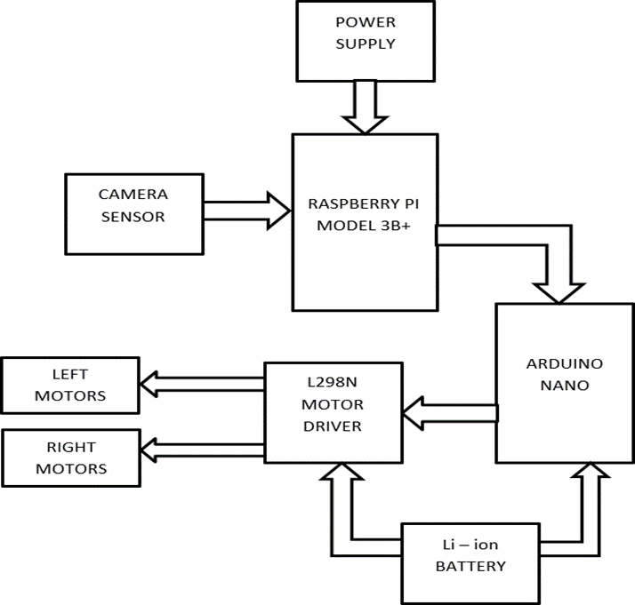
Block Diagram

Slide 10
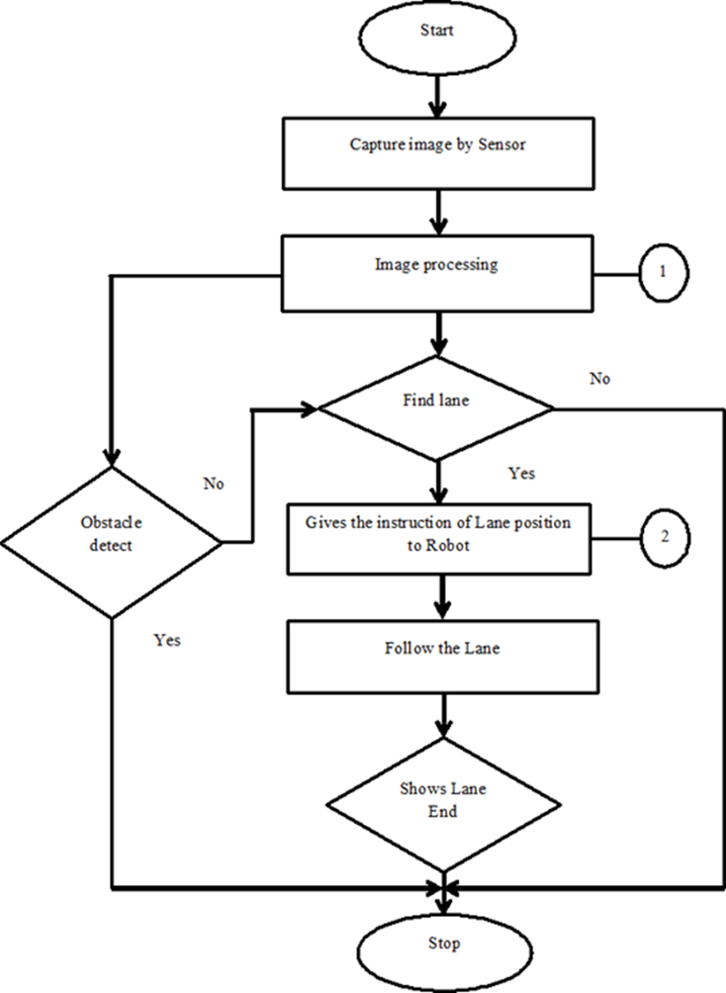
Flow of Project

Slide 11
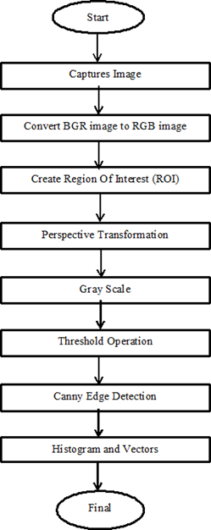
Image Processing flowchart

Slide 12
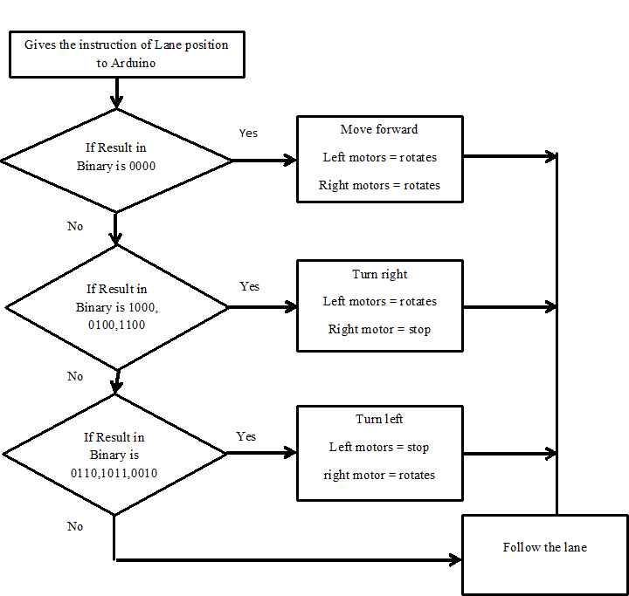
Motor Controller Flowchart

Slide 13
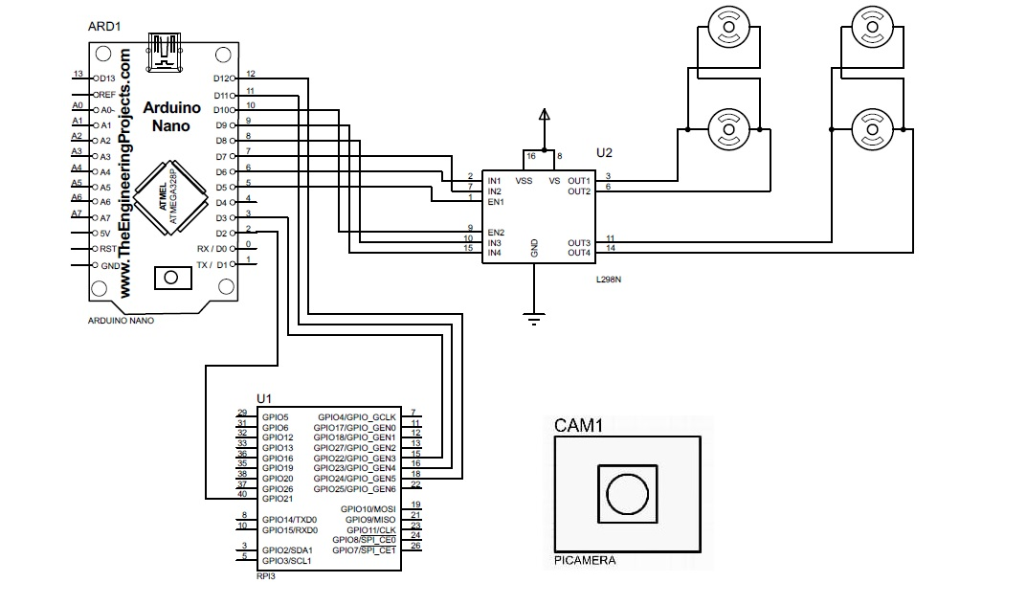
Circuit Diagram

Slide 14
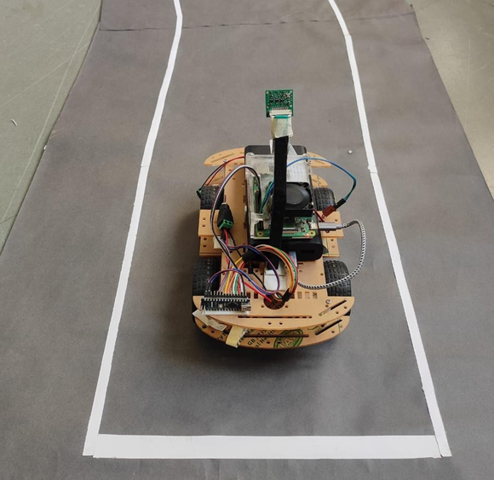
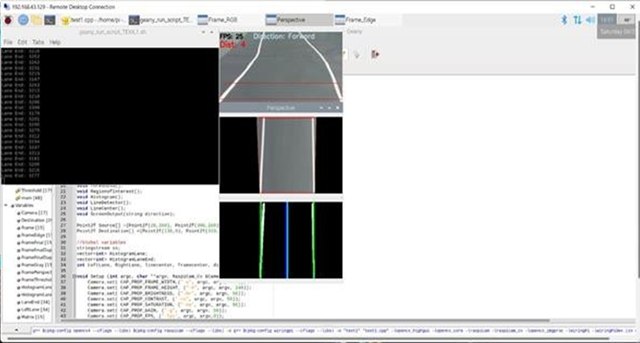
Results
Robot moving Forward Direction Result showing Forward Direction

Slide 15
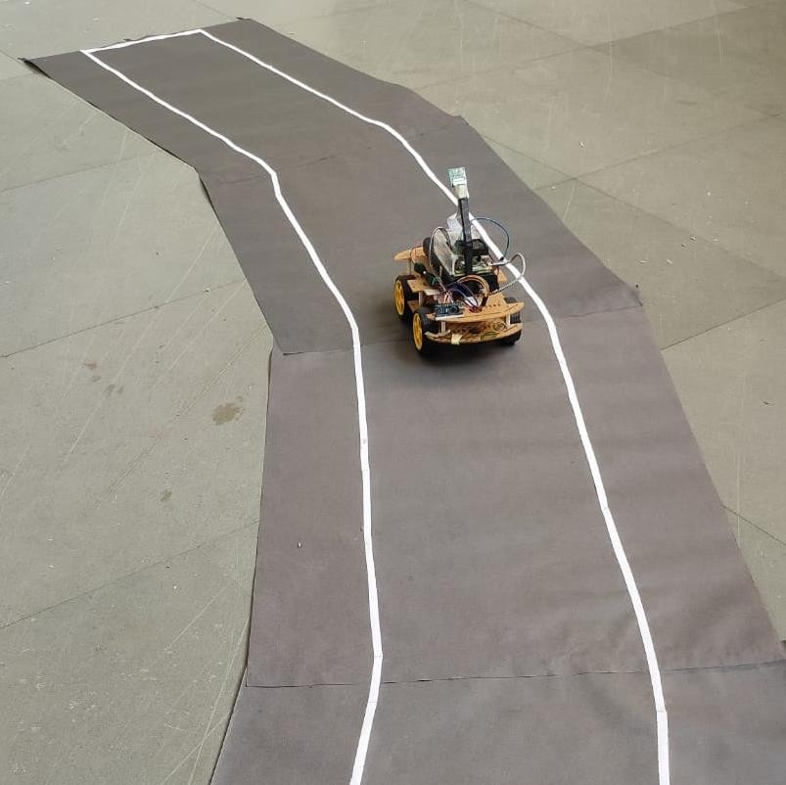
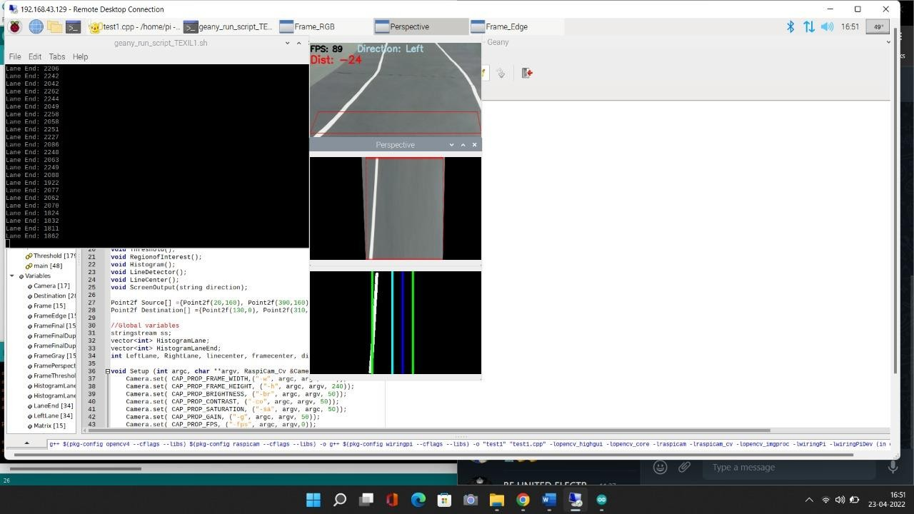
Robot moving Left Direction Result showing Left Direction

Slide 16
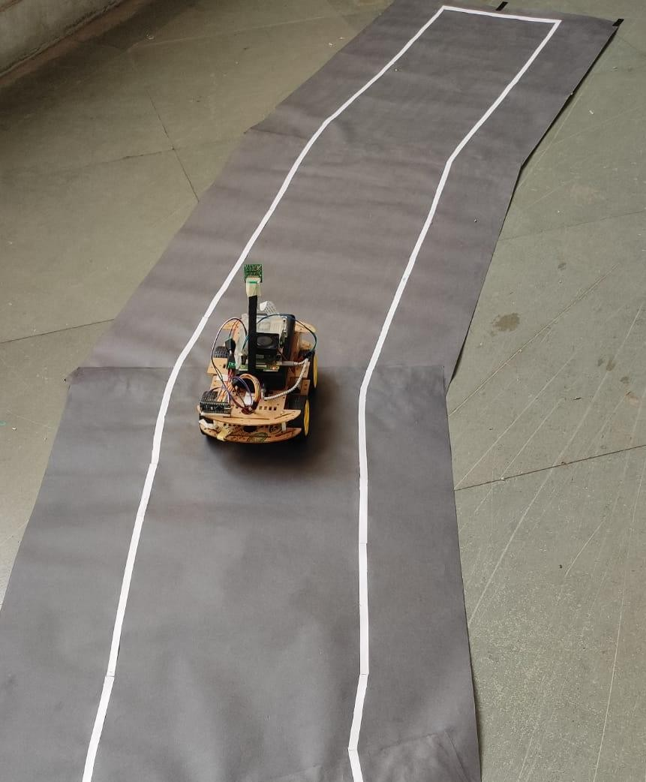
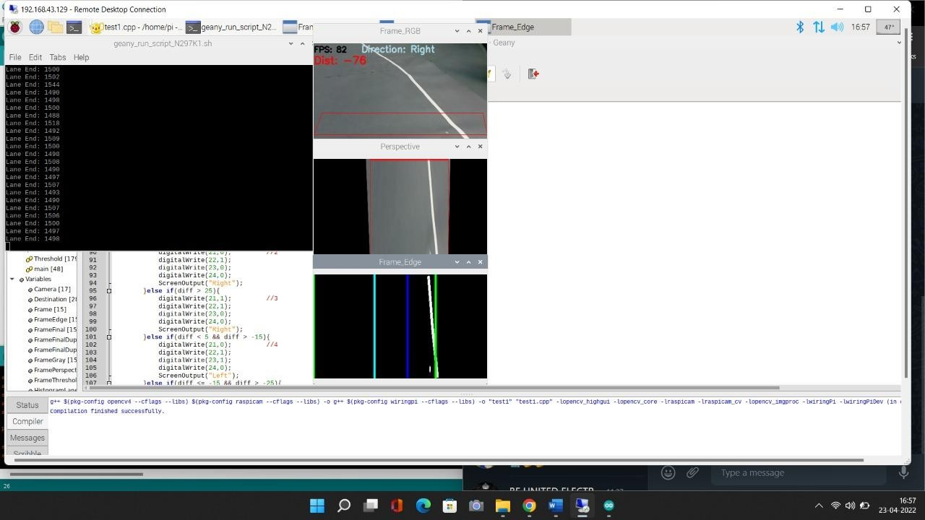
Robot moving Right Direction Result showing Right Direction

Slide 17
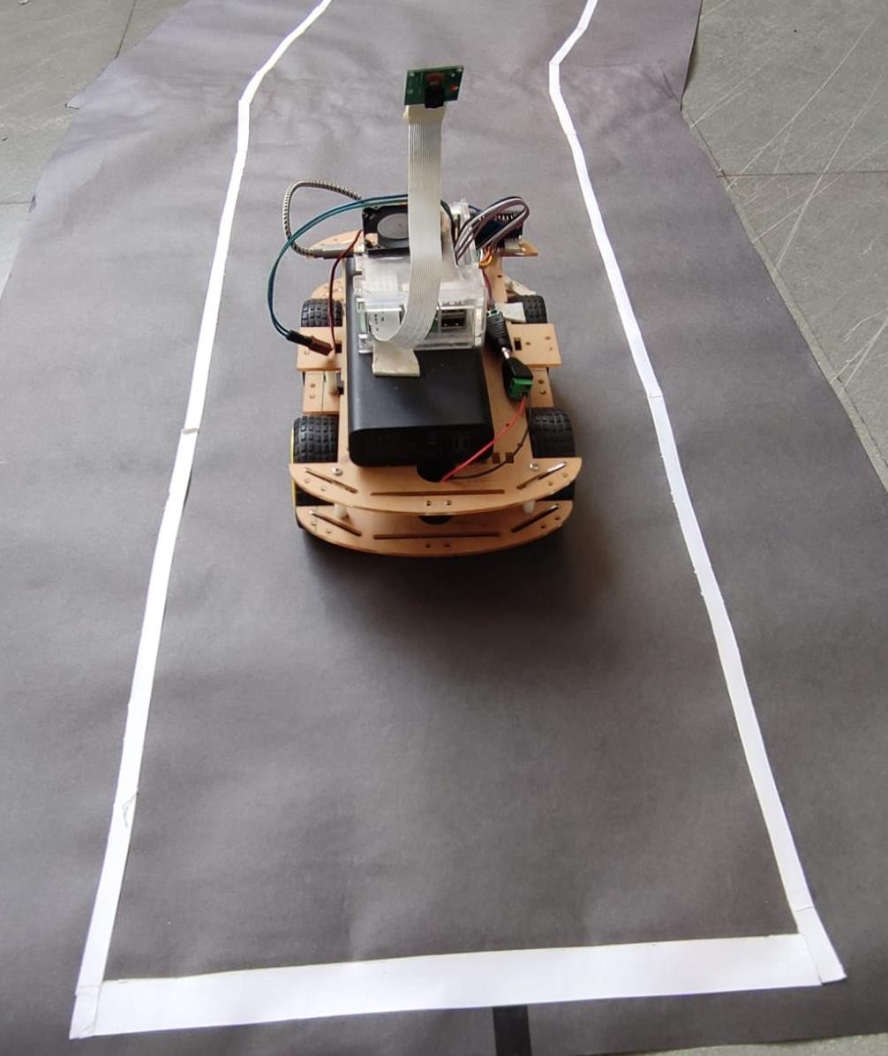
Robot stopped at Lane End

Slide 18
Limitations
The approach is costly for small scale industries.
The robot calibration would affect due to worst case scenario of weather change.
We would need a high pixel range camera for better calibration.
At slope areas robot wouldn’t be working efficiently.

Slide 19
Future scope
The major advantages of this system when compared to other Lane detection algorithms is that this system is more reliable and efficient to detect lane and maneuver the robot using Arduino Nano.
By using different cameras, we can change the applications example night vision, thermal, etc.
With few changes this system can also be implemented in drones.
By using 2 cameras we can create a 3D image of the environment.
Assertive navigation system for wheel chair and blind people.
It can go in hazardous environment where humans cannot go.

Slide 20
Conclusion
This project report presents a camera sensor-based Lane Following Mobile Robot design which always directs along the white line on gray surface. The robot is able to detect its path in case it is out of path. The robot also detects obstacles coming between the path and responds accordingly. Thus the “LANE FOLLOWING MOBILE ROBOT” has been designed and tested successfully.

Slide 21
References
[1] Shetty Nihal, K Mohan, K Kaushik, “Autonomous Self-Driving Car using Raspberry Pi Model”, International Journal of Engineering Research & Technology (IJERT), RTESIT - 2019 Conference Proceedings, ISSN: 2278-0181
[2] Yu-Fang Wang, Yi-Shueh Tsai, “A lane detection method based on 3D-LiDAR”, Automotive Research & Testing Center (ARTC), Changhua, Taiwan (R.O.C), ISSN: 2018
[3] Jong-Ho Han, Hyun-Woo Kim, “Lane Detection Algorithm Using LRF for Autonomous Navigation of Mobile Robot”, Appl. Sci. 2021, 11, 6229, https://doi.org/10.3390/app11136229
[4] Kanjee Ritesh, Bachoo Asheer, Carroll Johnson, “Vision-based Adaptive Cruise Control using pattern matching”, IEEE 2013 6th Robotics and Mechatronics Conference (RobMech) - Durban, South Africa (2013.10.30-2013.10.31), 93–98, doi:10.1109/robomech.2013.6685498

Slide 22
THANK YOU

